Slide 1
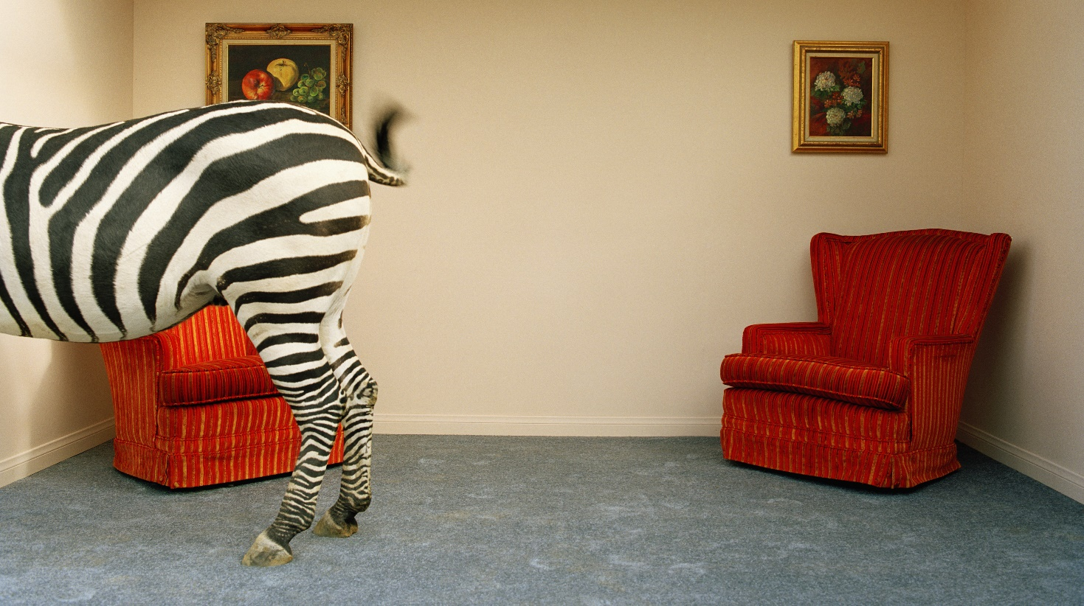



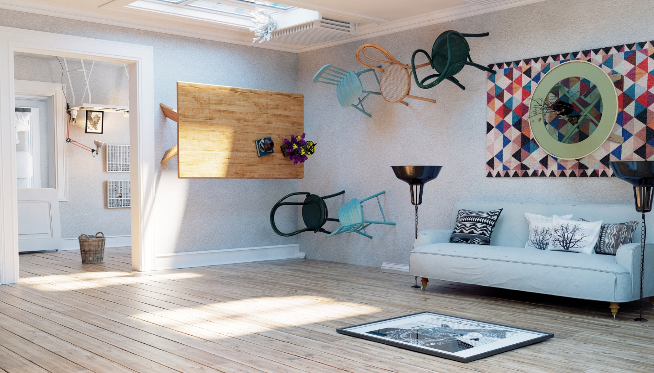
Comp Sys Assignment 2
Project Title: Smart Home Office Manager
Student# : 20091380
Name : Seamus McCarthy

Slide 2

Problem
The Covid-19 pandemic has had a profound impact on established work practises. In October 2020, the labour market think tank Eurofound had noted that approximately 40% of paid hours were performed from home at the height of the Covid-19 pandemic.
https://www.irishtimes.com/business/work/ireland-had-one-of-highest-rates-of-home-working-during-covid-19-crisis-1.4369346
Though we can now see a time where we might return to the office environment, it is reasonable to expect that many companies will retain a work from home policy to some extent.
However, working from home can present its own difficulties such as:
The ergonomics of the home office space (light, heat, humidity)
Time management & monitoring worked hours
Distractions (children, pets, home tasks)
It is often easy to overlook the impact of these factors on our day-to-day performance.

Slide 3

Whimsical Room 4
SHOM : Smart Home Office Manager
SHOM is a Python web application running on a Raspberry Pi that is designed to allow remote workers to maximise their control of the home office environment, highlight any problematic patterns in their working hours and alleviate some issues associated with working from home. It will allow the user to :
Log in automatically via motion sensor & Bluetooth device identification
Measure room temperature and humidity via a Sense Hat
Control their office environment via TP-Link Smart Plugs & IFTTT
Utilise a “Do Not Disturb” function via a TP-Link Smart Bulb & IFTTT
Record their working hours to user-specific Thingspeak channels
Log user-specific break times & interruption durations to a Firebase database
Remote monitor other parts of the home using a 2nd Raspberry Pi & PiCamera
Concept

Slide 4
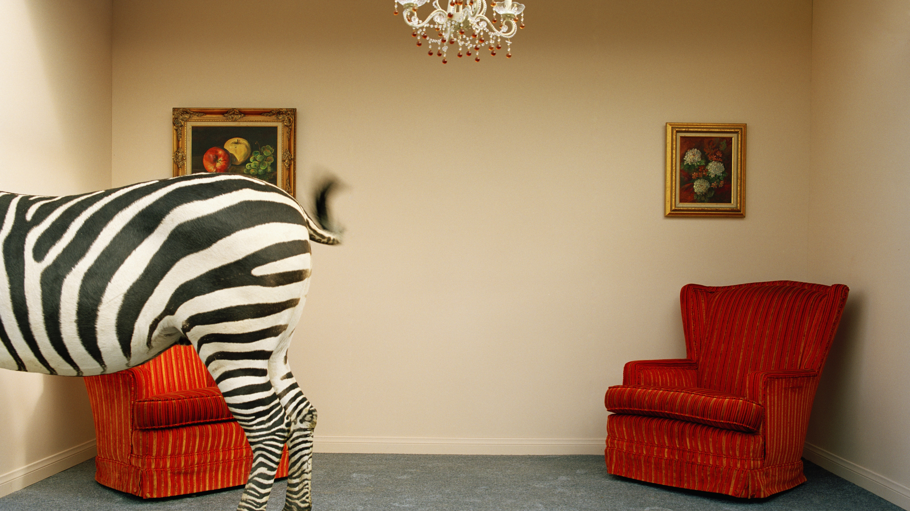
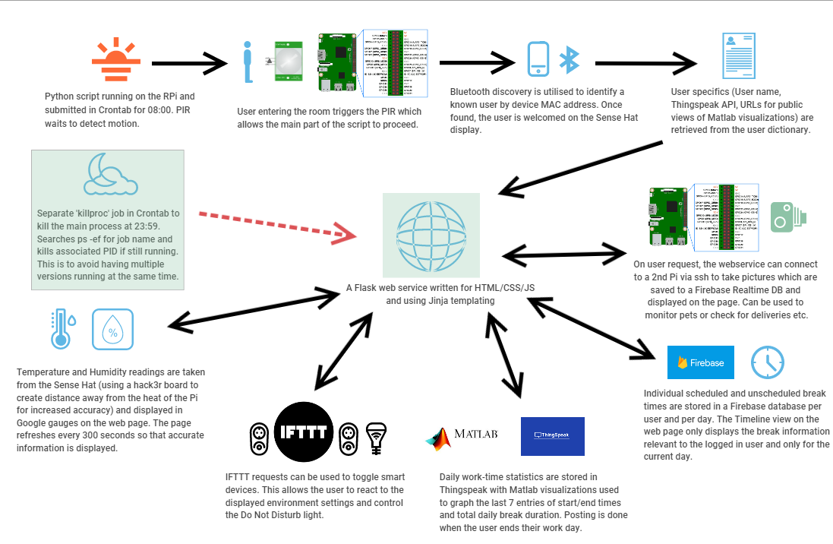
Whimsical Room 1
Project Components

Slide 5
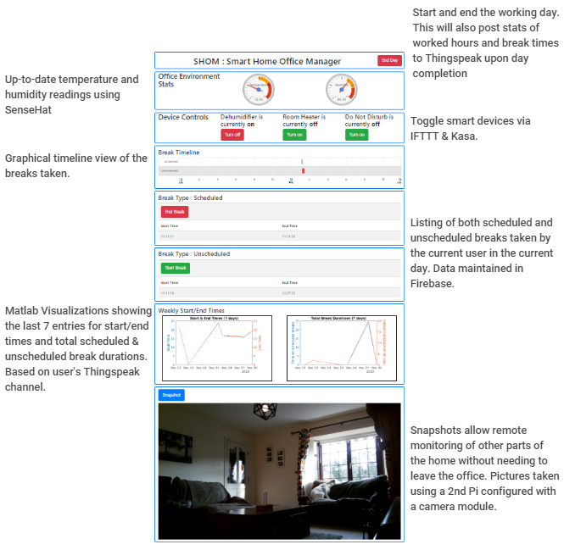
Whimsical Room 1
Webpage Guide

Slide 6
Application Details
Initial Setup & User Identification
A Python script is configured to auto-run each morning. This performs initial setup and primes the PIR sensor to wait for motion.
When motion is detected, a Bluetooth symbol is shown on the SenseHat display to inform the user that device detection is underway.
When a device is detected, this is checked against a dictionary of known devices for a match.
If no match is found, a message is displayed, and the program ends.
If a match is found, this identifies the user and associated details such as the API keys & public URLs for their Thingspeak channel. The user is greeted on the Sense Hat display.
A dictionary is then loaded for known smart devices and another is populated from existing Firebase break data for the known user and the current day.
The web service is launched passing the smart device and break information into the page.
Web service
A Flask web service running on port 5000 that utilizes Jinja templating for displaying multiple records from the devices dictionary and from the break time data passed in from Firebase.
The page will auto-refresh every 300 seconds to ensure that the sensor readings are constantly updated. These are displayed using Google gauges.
Various buttons are connected to routes and used for controlling the smart devices and stopping/starting break times and the working day log on/off times.
Scheduled & Unscheduled break times are listed and also displayed in a Google Timeline view.
The latest snapshot photo is also retrieved from a Firebase RealTime database and displayed on page. The user can request snapshots which triggers a Python script on a 2nd remote Raspberry Pi to be executed which takes the photo and uploads it to the database.

Slide 7
Application Details
Technical Details
The pr2.py script is submitted in Crontab at 08:00 each morning.
PIR motion sensing uses the gpiozero library and the PIR is setup on GPIO pin 4
Bluetooth user identification uses the PyBluez package and communication is happening in the 2.4 GHz spectrum.
A SenseHat is used to record the temperature and humidity on each page request/refresh. The Sense Hat is connected to the Pi via a hacker board which removes the issue of the readings being affected by the heat of the Pi board and thus provides more accuracy as well as allowing access to the GPIO pins for the PIR.
IFTTT requests will be used to toggle the state of the smart devices. Requested via HTTP, the requests connect a webhook maker event with TP-Link Kasa to control the smart devices.
Firebase DB will be used to record the break times. These are posted and retrieved using REST APIs.
Firebase is also used to store the picture snapshots. These are retrieved using Javascript as per the lab in week 10. The Javascript file can be found in the ‘static’ folder as per Flask guidelines.
Thingspeak channels will record the day values (log on/off times, total break durations). These values are posted to Thingspeak via REST API posting when the user ‘ends’ their working day.
MATLAB visualizations were written to show the start/end times in one visualization and the total daily scheduled/unscheduled break durations in another. Each visualization shows data from the last 7 entries.
SSH keys were generated to allow the main Pi to remotely execute the snapshot script on the 2nd Pi without having to specify a password. The keys were generated using ssh-keygen and copied using ssh-copy-id. Execution of the remote script from within the main Python script also required the use of the subprocess library.
A ping entry added to crontab is used to maintain the connection between the 2 Pi’s. This is being done as it was noticed that without regular contact, the 1st Pi was losing the details of the 2nd Pi and was unable to submit the command to take a picture. The ping is limited to 15 attempts and executes every 2 minutes.
Another script is configured in crontab to run at 23:59 and find any processes running with the name pr2.py. If found, the process is killed.

Slide 8
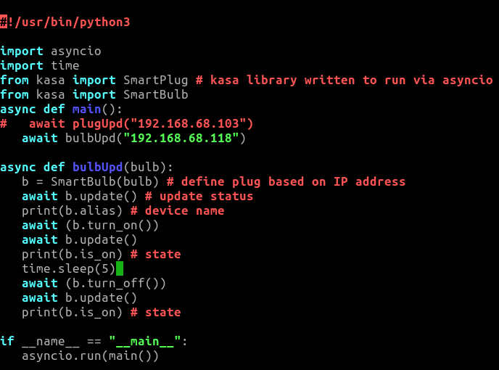
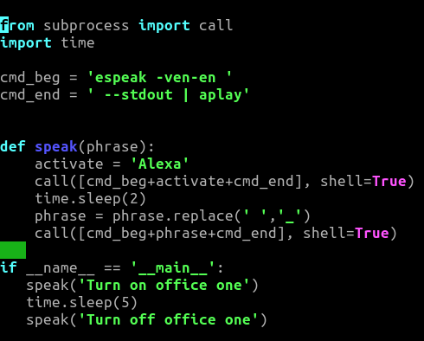
Other considerations and issues
Tkinter
I had initially considered basing the solution completely in Python and using Tkinter for creating a GUI control panel and CloudTK to display the app in a browser. However, as it had not been covered in the course, it felt like a lot to take on and would also mean having to learn on the fly how to add in the various external elements I needed. The safer option was to use a Flask web service.
Python-kasa
Initially, I had wanted to use Python-kasa to control the TP-Link devices. This was prototyped and found to work as I wanted. It also meant I would have to use a Quart webservice rather than Flask as Python-kasa utilizes asyncio which doesn’t appear to be compatible with Flask. However, a forced TP-Link firmware update in early November blocked the port that is required for the python-kasa package to work. Though a fix is being worked on in Github, I have switched the solution to use IFTTT requests to toggle the device states. Though this offers less functionality than Python-kasa, it suffices for now. As such, I have also moved back to a Flask webservice as I no longer require asyncio.
Cloud4RPi
Cloud4Rpi was looked at briefly as a possible dashboard replacement but didn’t appear to have an option for displaying table data such as the break start/end times. I looked at using it only for sensor data and devices switches so that it could be embedded into my webpage as an iframe but the public view of the dashboard is read-only so I cannot utilize this for switches and the private view has an unsightly ‘Register/Sign-up’ prompt. I will continue with the plan to use Google Gauge charts for the sensor readings and maintain everything else within the webpage. This will have the added benefit of meaning that in order to add more smart devices, I only need to add them to the relevant dictionary in my script rather than modify a 3rd party dashboard.
Ping keepalive script
I had some issues maintaining a connection to the 2nd Pi as it seemed to disappear from ‘arp –a’ lists. To get around this, I added a script into my crontab which pings the IP address (stops after 15 attempts) every 2 minutes. This has so far appeared to correct the issue.
Firebase DB expiry
Ran into a slight issue when my Firebase DB expired. This was down to having it in Test Mode which only grants open access for 30 days. Managed to resolve this by updating the expiry date as set in the Rules settings.
Voice Controlled Devices
I also toyed with the idea of having the Smart devices voice controlled. Again, this was reliant on using Python-kasa so was hindered by that same firmware update. I did fashion a workaround where I could connect my Raspberry Pi to a speaker and get it to ‘speak’ a command which was picked up by an Amazon Echo Dot. The Dot was then able to control the devices using Alexa skills. In the end, this workaround just seemed a little unwieldy and didn’t really demonstrate a whole lot of acquired knowledge so was dropped.

